Slide 1
Chapter 1:
Rational Numbers
Lesson 1:
Rational Numbers
Let’s Explore English in Maths
Grade 7

Slide 2
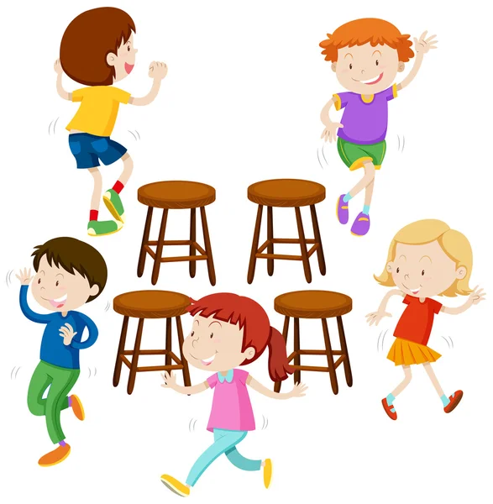
Warm-up
Passing the objects

Slide 3
Warm-up
How to play
Students sit in a circle.
When the music is on, students pass the objects around the circle.
When the music stops, the students holding the objects must stand up and answer a question from the teacher.
Students who answer correctly earn 1 point for their team.
The team with the most points wins.
Passing the objects

Slide 4
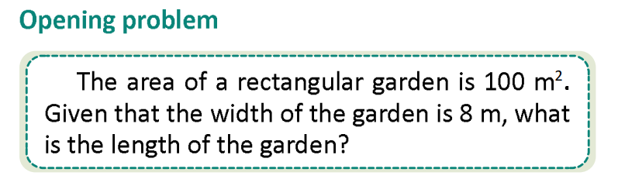
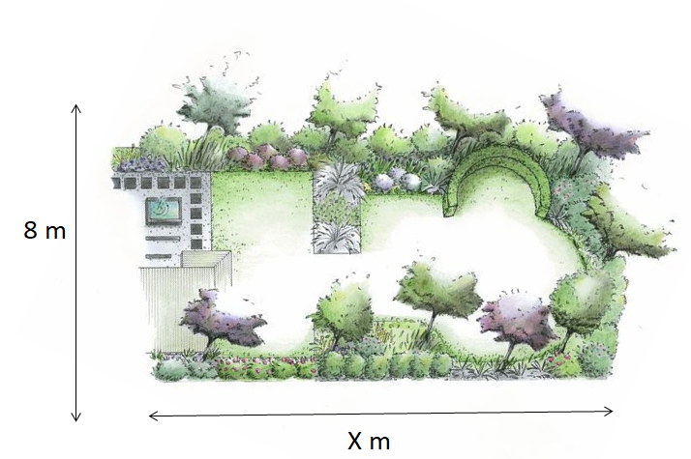
Lead-in
Area of the garden: 100 m²
The width of the garden: 8 m
Therefore, the length of the garden: 100 : 8 = 12,5 m²

Slide 5


A. Pronunciation
a) Listen to the sound /ae/.
b) Listen to the following words and focus on the underlined letters.

Slide 6
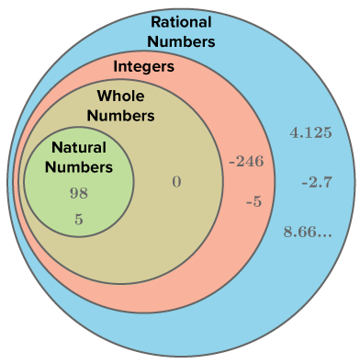
Vocabulary
rational number
/ˌræʃ.ən.əl ˈnʌm.bər/
a rational number can be written as a fraction, where the numerator and denominator are integers.

Slide 7
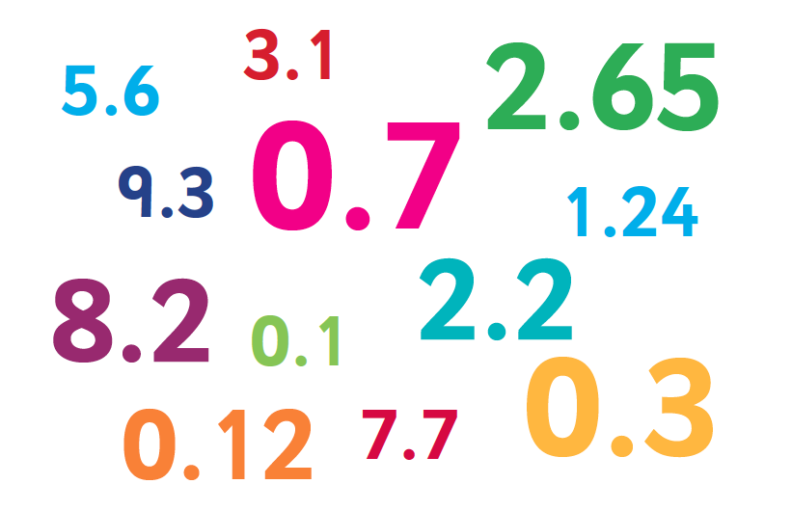
Vocabulary
decimal
/ˈdes.ɪ.məl/
a number written with a dot to separate the whole number part from its fractional part.

Slide 8
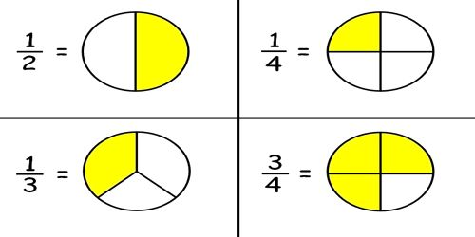
Vocabulary
fraction
/ˈfræk.ʃən/
a fraction shows a part of a whole.

Slide 9
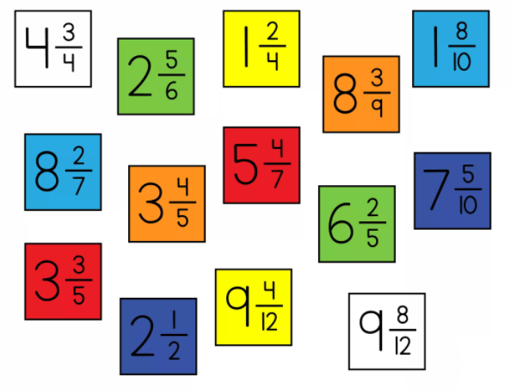
Vocabulary
mixed number
/ˌmɪkst ˈnʌm.bər/
a number that combines a whole number and a fraction.

Slide 10
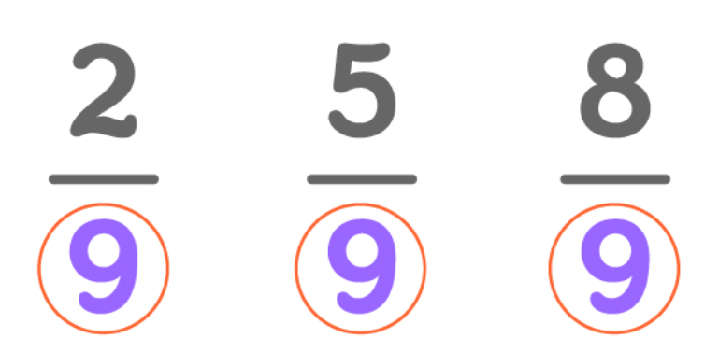
Vocabulary
common denominator
/ˌkɒm.ən dɪˈnɒm.ɪ.neɪ.tər/
a number that can be used as the bottom number for two or more fractions to be compared or added together.

Slide 11
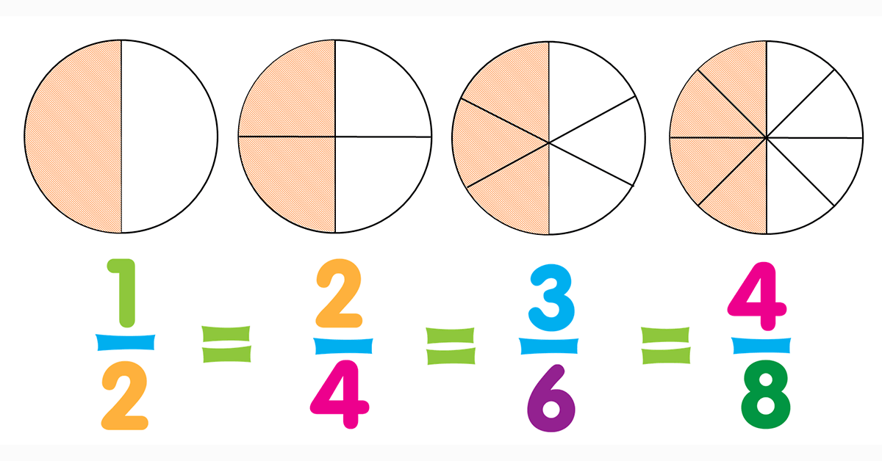
Vocabulary
equivalent fraction
/ɪˈkwɪv.əl.ənt ˈfræk.ʃən/
different fractions that show the same amount.

Slide 12
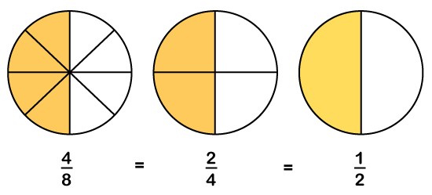

Review
Match the words below with the pictures.
1. rational number
2. decimal
3. fraction
4. mixed number
5. equivalent fraction
6. common denominator
a
b
c
d
e
f

Slide 13
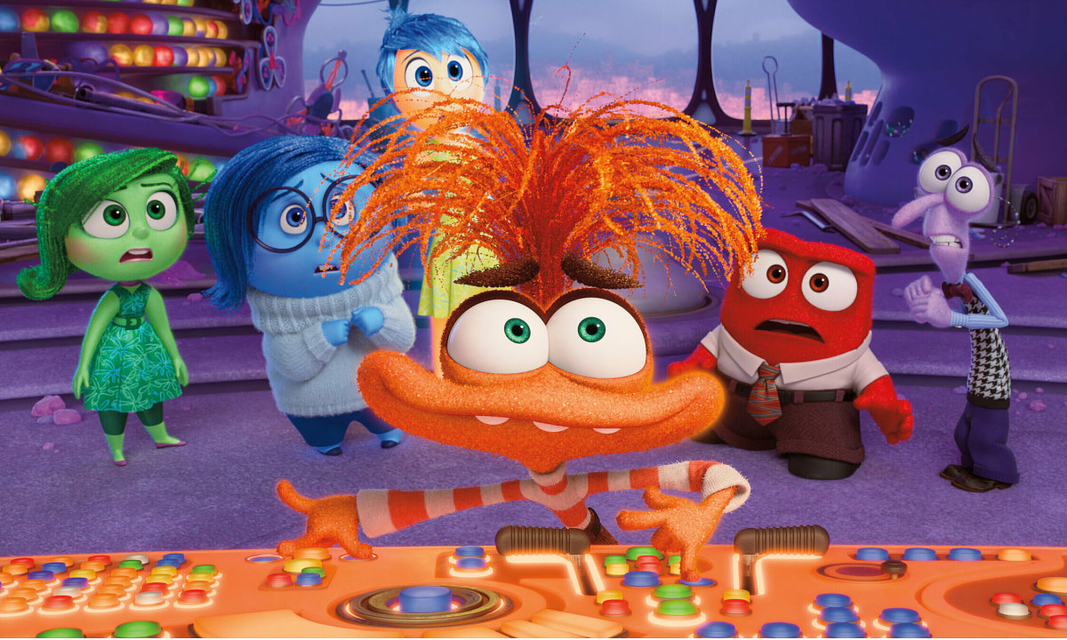




Slide 14

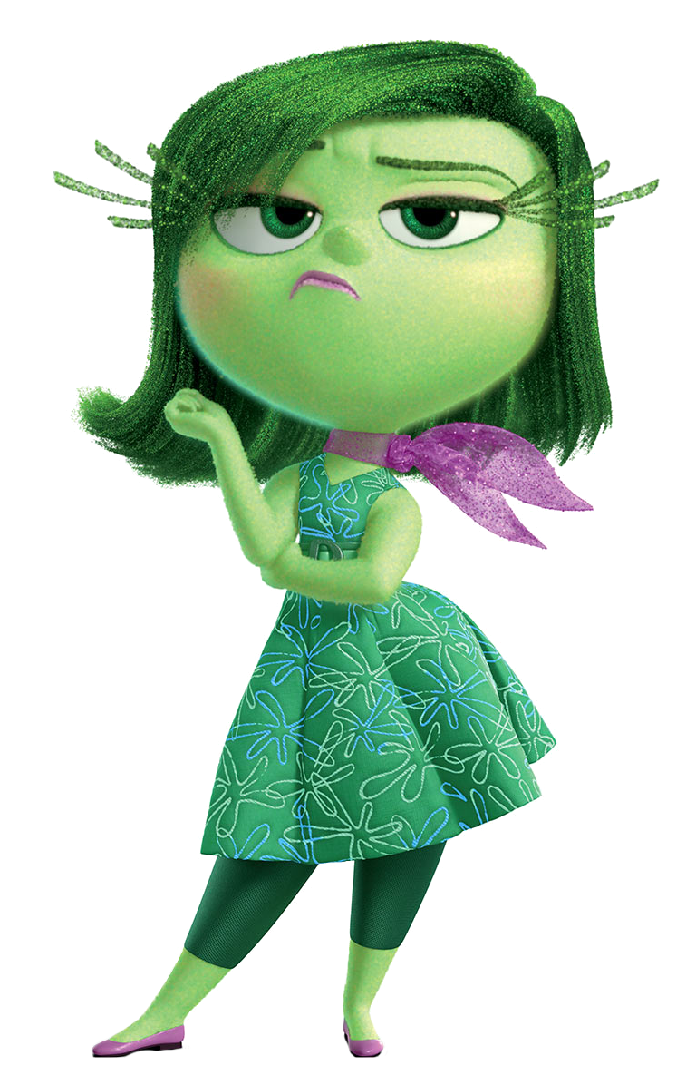






A number written with a dot to separate the whole number part from its fractional part.
A. decimal
B. fraction

Slide 15
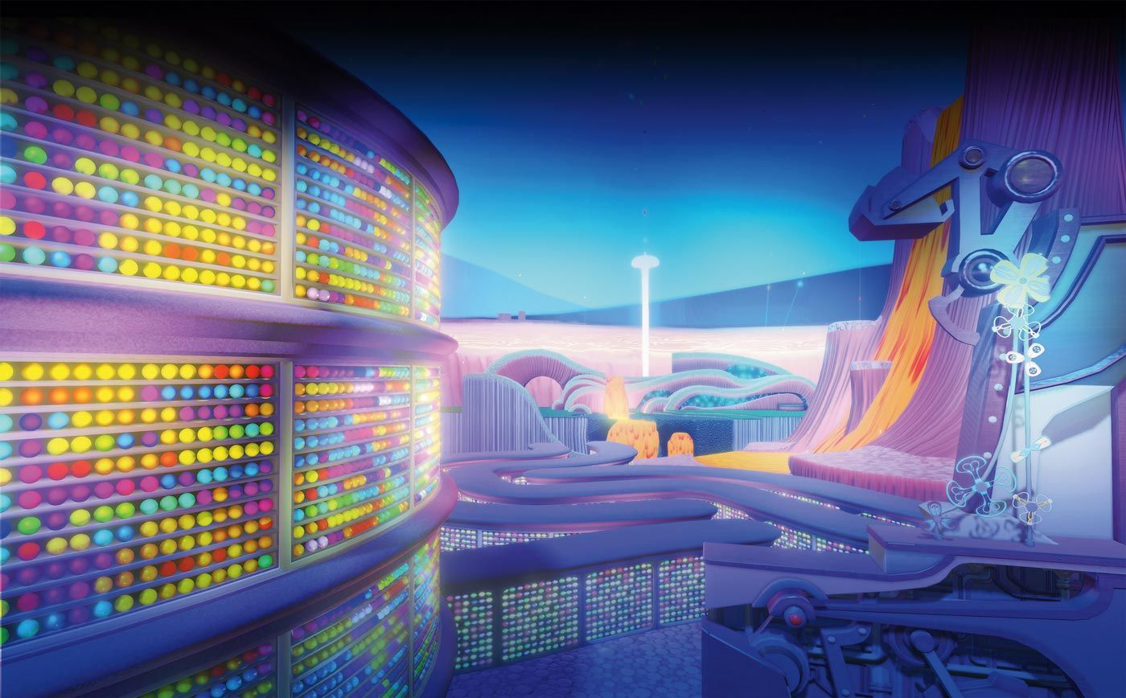

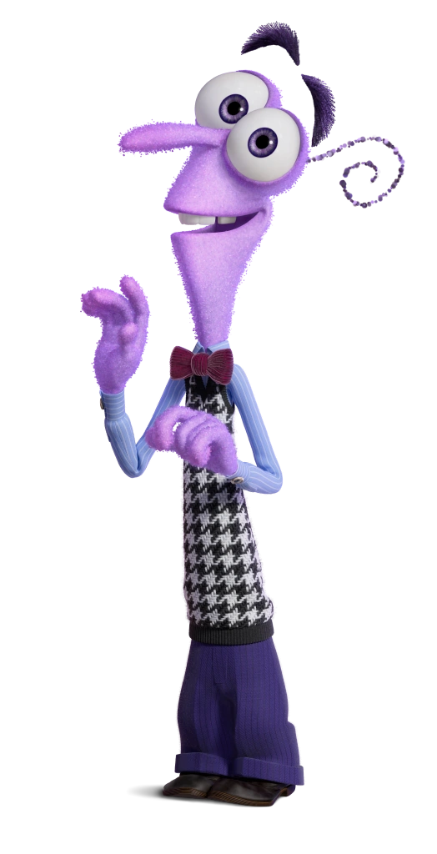
A number that can be used as the bottom number for two or more fractions to be compared or added together.
A. equivalent fraction
B. common
denominator

Slide 16



A number that combines a whole number and a fraction.
A. mixed number
B. decimal number

Slide 17

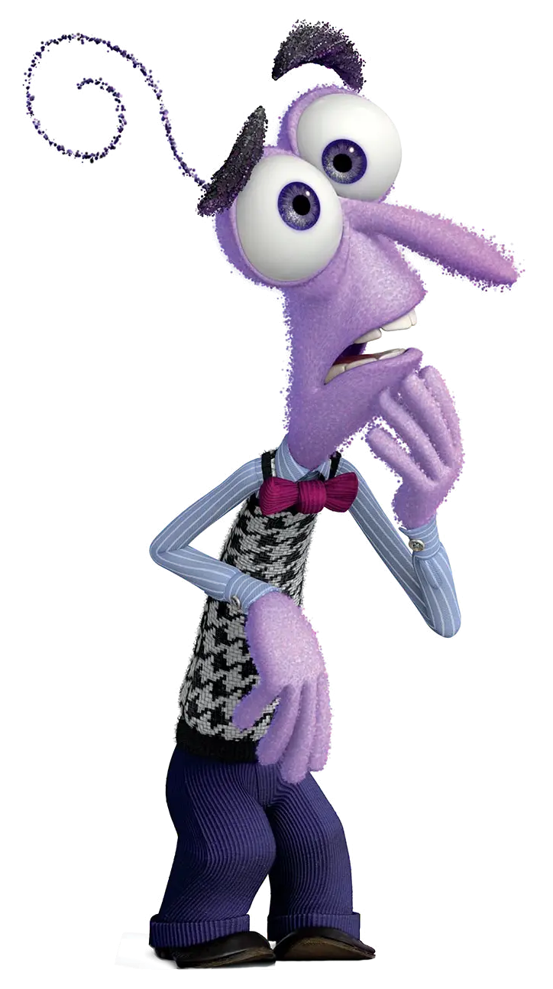
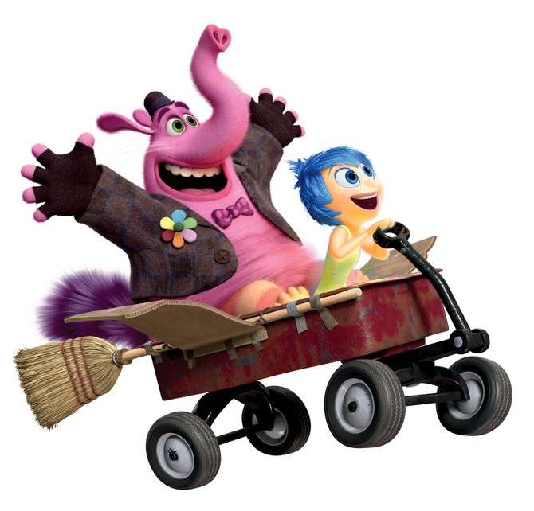
A part of a whole
A. decimal
B. fraction

Slide 18
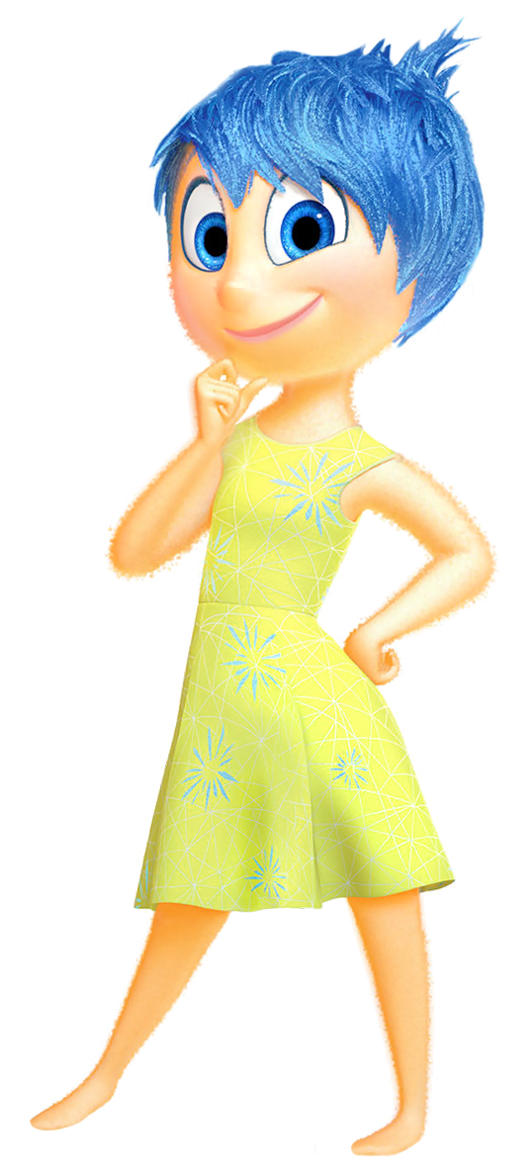
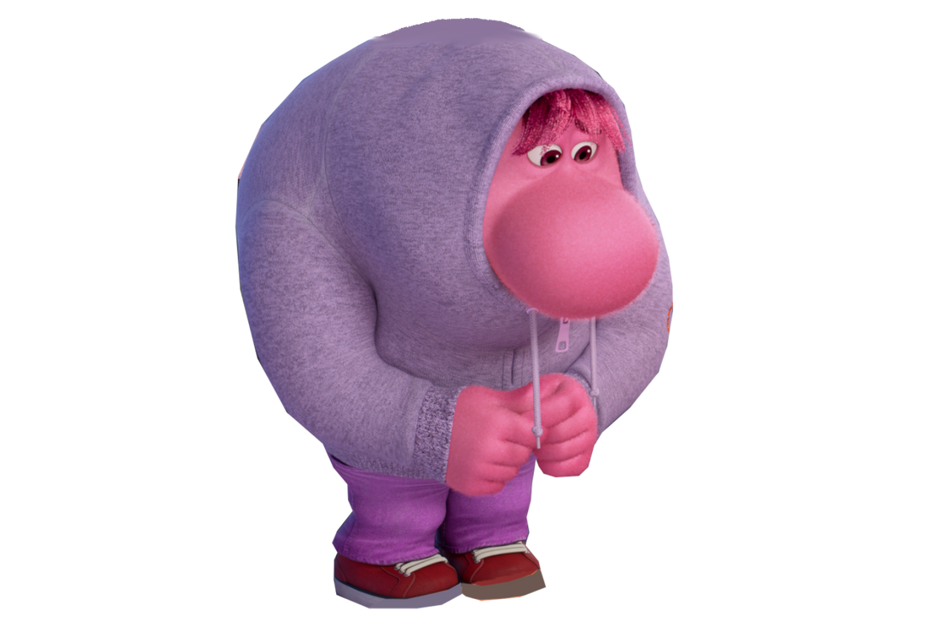
Different fractions that show the same amount.
A. equivalent fraction
B. common denominator

Slide 19
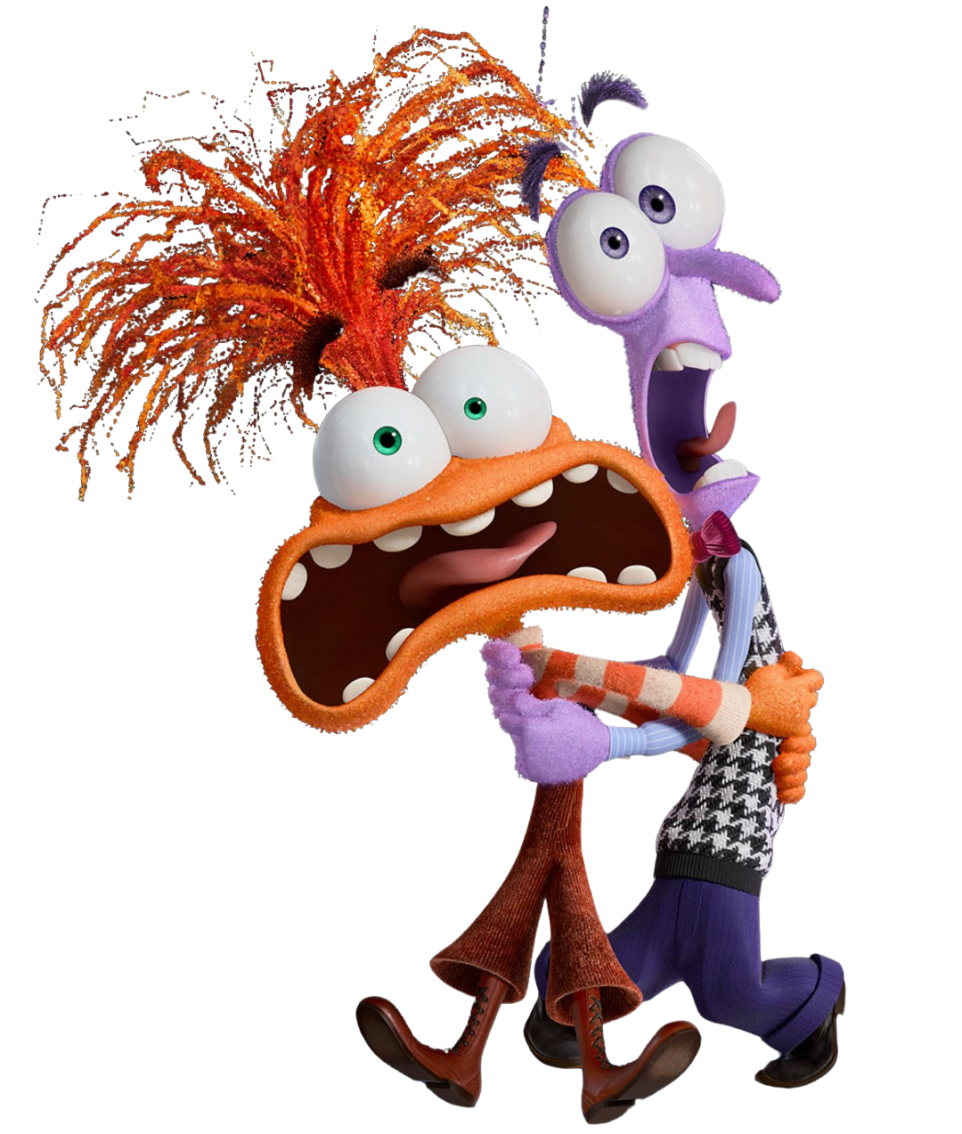

A number can be written as a fraction, where the numerator and denominator are integers.
A. Natural number
B. Rational number

Slide 20
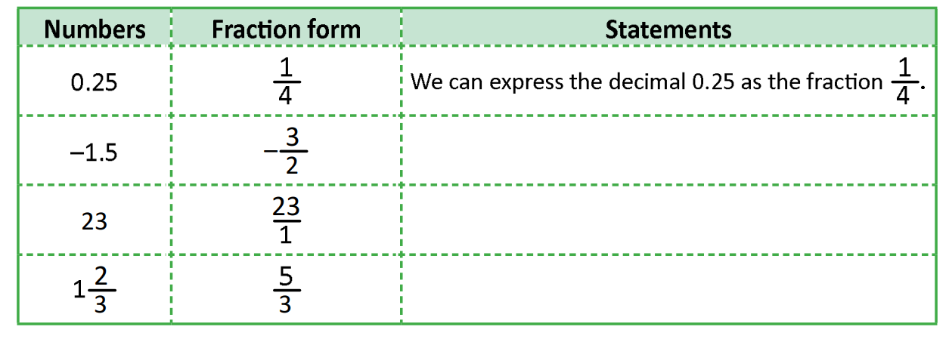



B. Practice
Write the suitable statements using “express … as…” or “convert … into”
We can express the decimal -1.5 as the fraction $−\frac{3}{2}$.
We can convert number 23 into $\frac{23}{1}$.
We can convert number $1\frac{2}{3}$ into $\frac{5}{3}.$

Slide 21

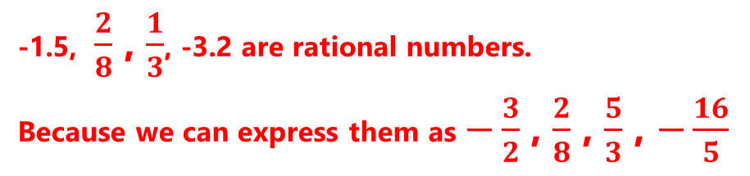
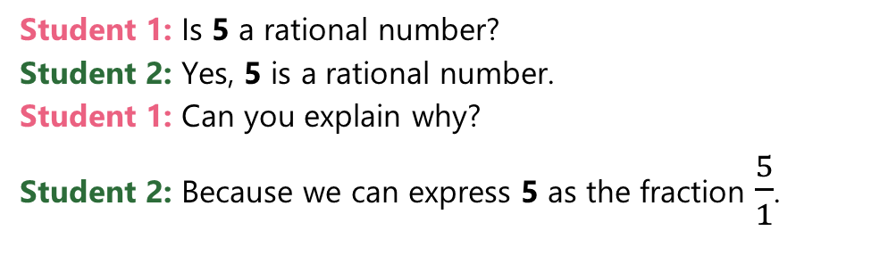
C. Speaking
Work in pairs,
Ask and answer whether the followings are rational numbers.
Student 1: Is 5 a rational number?
Student 2: Yes, 5 is a rational number.
Student 1: Can you explain why?
Student 2: Because we can express 5 as the fraction $\frac{5}{1}$.
-1.5, $\frac{2}{8}$ , $\frac{1}{3}$, -3.2 are rational numbers.
Because we can express them as $−\frac{3}{2}$ , $\frac{2}{8}$ , $\frac{5}{3}$ , $−\frac{16}{5}$

Slide 22
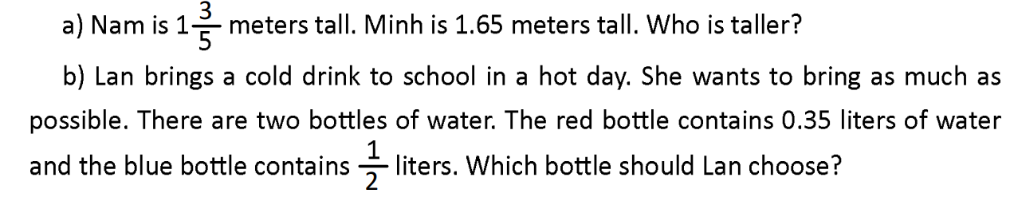

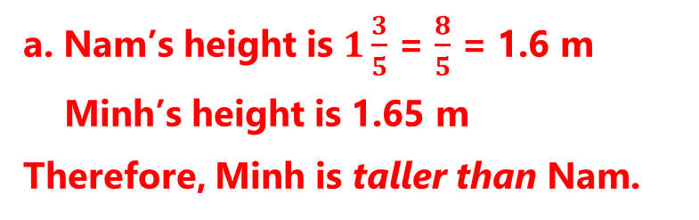
D. Writing
Solve the following problems.
a. Nam’s height is $1\frac{3}{5}$ = $\frac{8}{5}$ = 1.6 m
Minh’s height is 1.65 m
Therefore, Minh is taller than Nam.

Slide 23
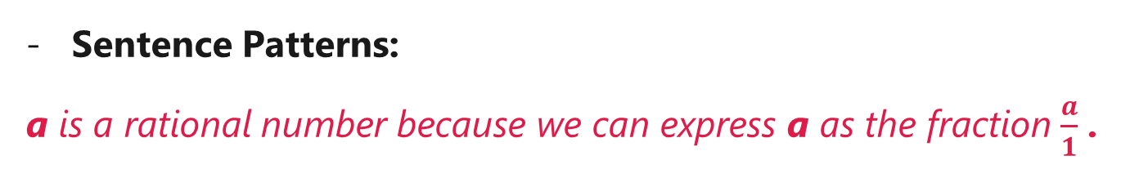
Consolidation
Vocabulary: rational number, decimal, fraction, mixed number, common denominator, equivalent fraction.
Distinguish the difference between rational numbers, decimals, fractions, …
Sentence Patterns:
a is a rational number because we can express a as the fraction $\frac{a}{1}$ .

Slide 24
Homework
- Review the vocabulary about Rational Numbers.
- Do exercise D. Writing – b.
- Prepare a new lesson: Lesson 3.

Slide 25
Math is the only subject that counts.

